Slide 1
Project One
King’s County Housing Data

Slide 2
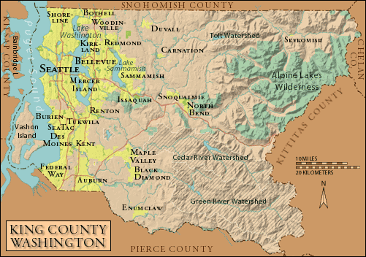
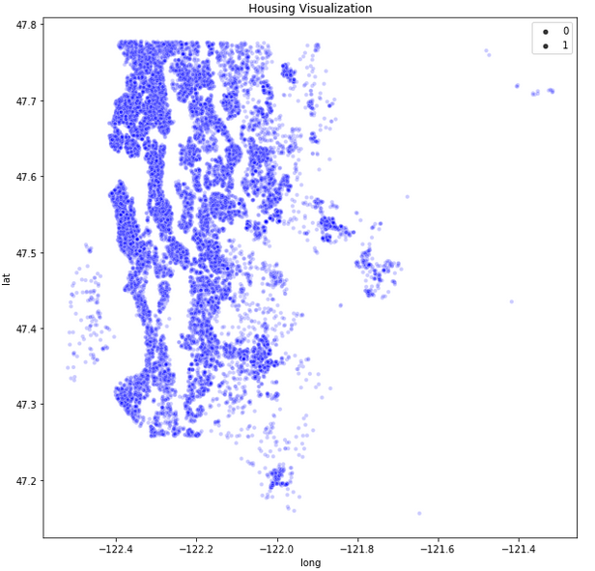
Housing Location

Slide 3
Key Drivers
Square footage
Lot
House
Basement
Grade
Floors
Views
Latitude

Slide 4
Value Added
Renovating the property by increasing square footage will have the most bang for your buck.
Example: If the lot size allows increase the square footage of the house by adding rooms (bedrooms or bathrooms)
Also by adding square footage to the property will increase the grade of the house by the county increasing value.

Slide 5

Head South
Houses located further south are cheaper.
Renovating houses in the southern area of King’s County is a good investment opportunity.

Slide 6
Marketing
Get word of out that the property is for sale. The more views the more bids on the house.

Slide 7
Key Takeaways
Increase square footage
Increases the grade by the county
Southern King’s County is cheaper
Let the property be known

